Slide 1
MSE – 803 – Data Analytics
Week 3 – Activity 2
Mukesh Dataset
Andre Benedetti
01/05/2026

Slide 2
Mukesh Dataset – Data Collection & Cleaning
Data Collection:
Before cleaning: 10 entries and 6 Fields After cleaning: 9 entries and 6 fields
Data Cleaning
Ensuring that all have the same format:
ID – int
Name – str
Country – str
Salary – float
Join Date - datetime (dd/mm/yyyy)
Handling duplicate:
If same ID plus at least 2 other features, merge
Handling wrong format:
Prompt the user to review data and enter correct format
Handling missing values:
Enter N/A as not available. These values will not be considered on the correlation analysis.

Slide 3
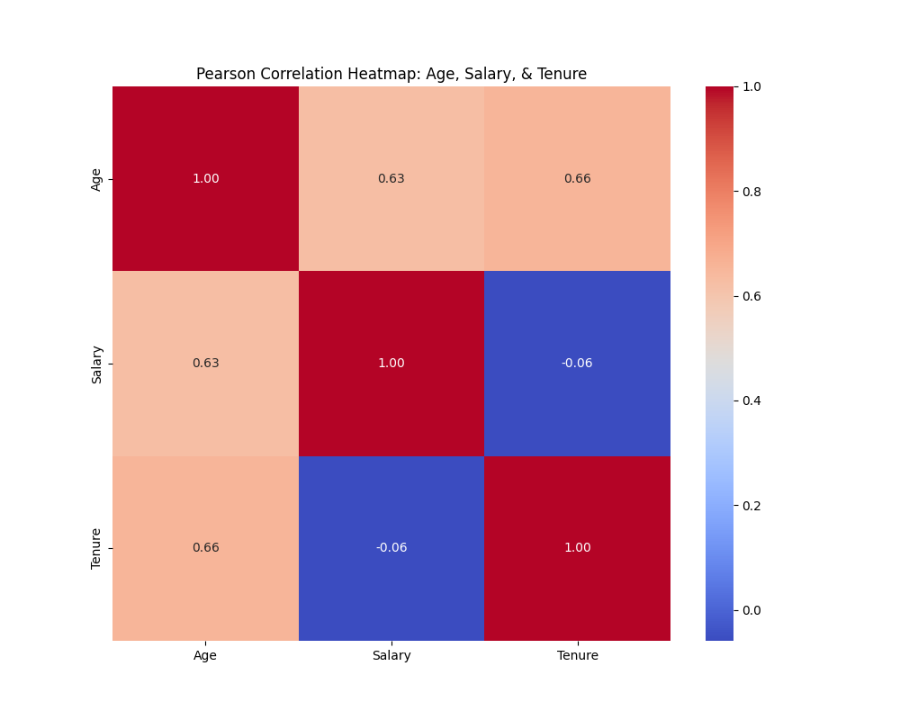
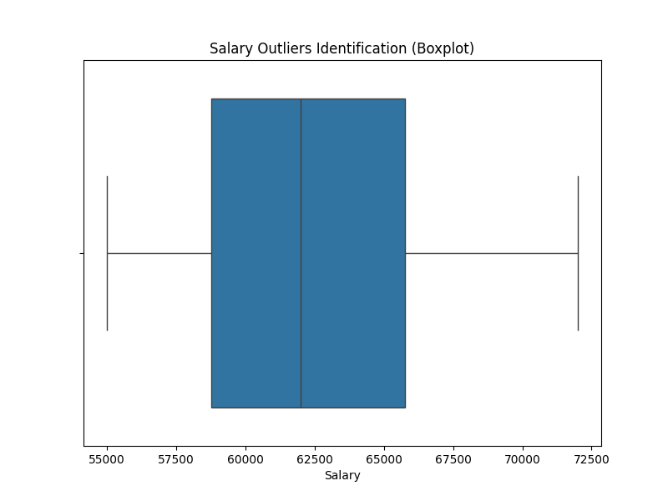
Mukesh Dataset – Correlation and Outliners
The correlation graphic shows a strong positive correlation between salary and ternure with age but a very low correlation between salary and ternure – the older the employee is, the longer he has been in the company and the higher is its salary.
The salary boxplot shows that there is no outliners regarding the salary.

